Slide 1

Game-Theory-Based Balance: Formalizing the Machine Unlearning Problem as a Game Between Model Provider and Data Provider
Machine Unlearning : Addressing the Challenge of Incorrectly Learned Information
Ph.D Pre-Proposal Presentation
by
Mr. Abhishek Hupele
Reg. No.: 240900465
Computer Scientist (PE), Research and Development - EV
EdgeVerve Systems Limited, An Infosys Company
Under the supervision of
Dr. Sanjay Singh
Professor (Guide)
School of Computer Engineering,
Manipal Institute of Technology, Manipal
Dr. P.C. Siddalingaswamy
Associate Dean (Co-Guide)
School of Computer Engineering,
Manipal Institute of Technology, Manipal
Dr. Naveen Kulkarni (Co-Guide)
Director – Product Engineering - AI
EdgeVerve Systems Limited, An Infosys Company
5
Sep 06, 2025

Slide 2
Presentation Overview
Introduction
Literature Review
Research Gaps
Objectives
Research Gaps to Objectives Mapping
Methodology
Course Work Details
Time Plan
References
Machine Unlearning : Addressing the Challenge of Incorrectly Learned Information

Slide 3
Introduction-I: Responsible AI
Responsible AI: The Foundation
Responsible AI (RAI) is about building AI systems that are:
Fair and unbiased
Transparent and explainable
Accountable and auditable
Privacy-preserving and secure
It emphasizes user rights, ethical data use, and compliance with legal frameworks.
Machine Unlearning: A Pillar of Responsible AI
Machine Unlearning is the process of removing the influence of specific data from a trained model.
The “Right to be Forgotten” (GDPR, CCPA), DPDP Act (India)
Ethical data revocation
Mitigation of bias and adversarial data
It ensures that AI systems remain compliant, fair, and adaptable.
Machine Unlearning : Addressing the Challenge of Incorrectly Learned Information

Slide 4
Introduction-II: Machine Unlearning
What is Machine Unlearning?
Not just data deletion—requires reversing learned representations.
Can be:
Exact (model is indistinguishable from one trained without the data)
Approximate (model behavior is statistically similar)
Applied at different granularities:
Data point, feature, class, user-level
Used in various model types: DNNs, LLMs, GNNs, SVMs, federated learning.
Why Machine Unlearning is Needed
Legal: GDPR (Article 17), CCPA/CPRA, DPDP Act (India) mandate data erasure.
Ethical: Users should control their data and revoke consent.
Security: Remove poisoned or adversarial data.
Maintenance: Update models without full retraining.
Machine Unlearning : Addressing the Challenge of Incorrectly Learned Information

Slide 5
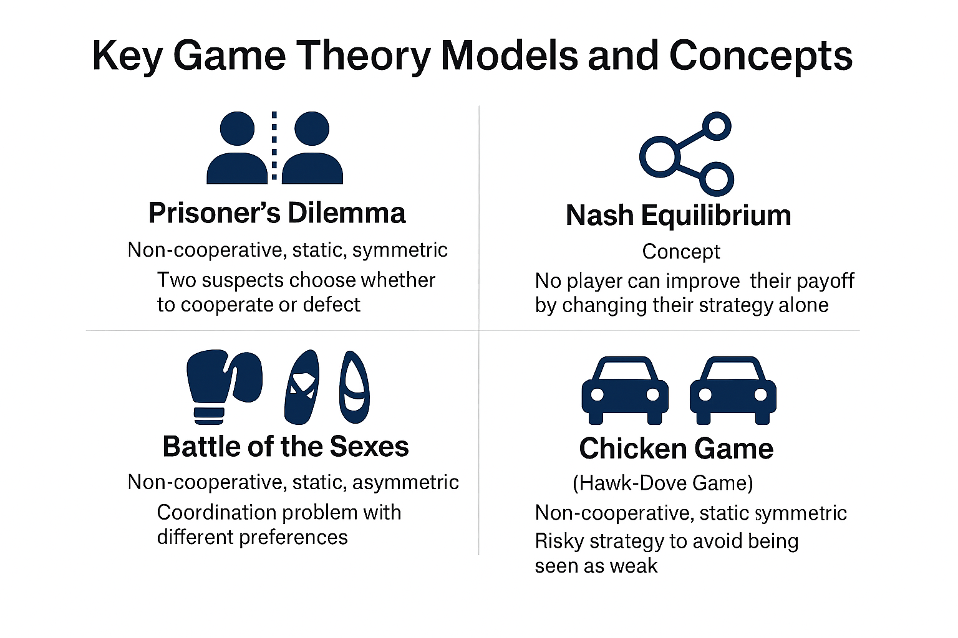
Introduction-III: Game Theory
Game theory is a branch of mathematics and economics that studies strategic interactions between rational decision-makers, often called "players." It provides a framework for analyzing situations where the outcome for each participant depends not only on their own choices, but also on the choices of others.
Here are some key concepts to understand game theory:
Players
Strategies
Payoffs
Information
Equilibrium
Figure 1.1:Figure 1:Strategic Interactions in Key Game Theory Models
(Source:Created by Abhishek Hupele using AI-generated visualizations via Microsoft Copilot (GPT-4))
Machine Unlearning : Addressing the Challenge of Incorrectly Learned Information

Slide 6
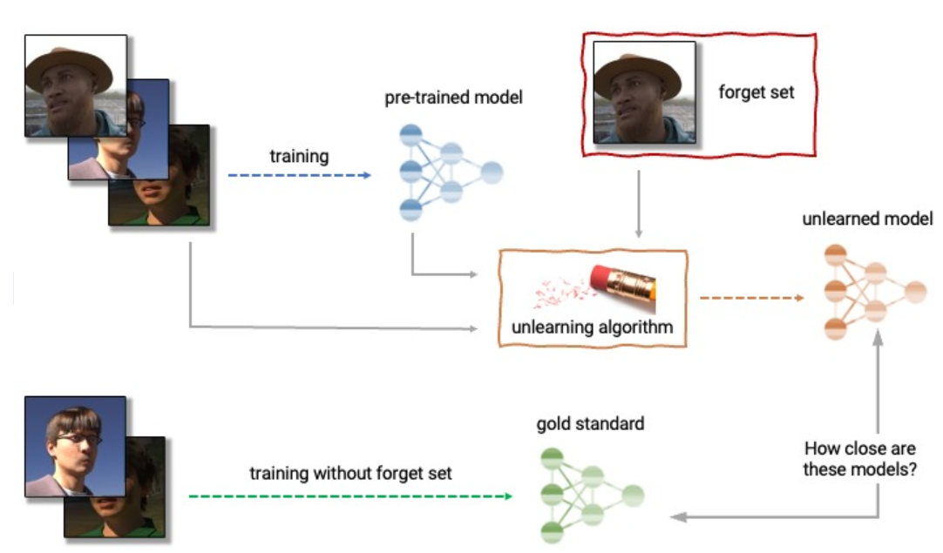
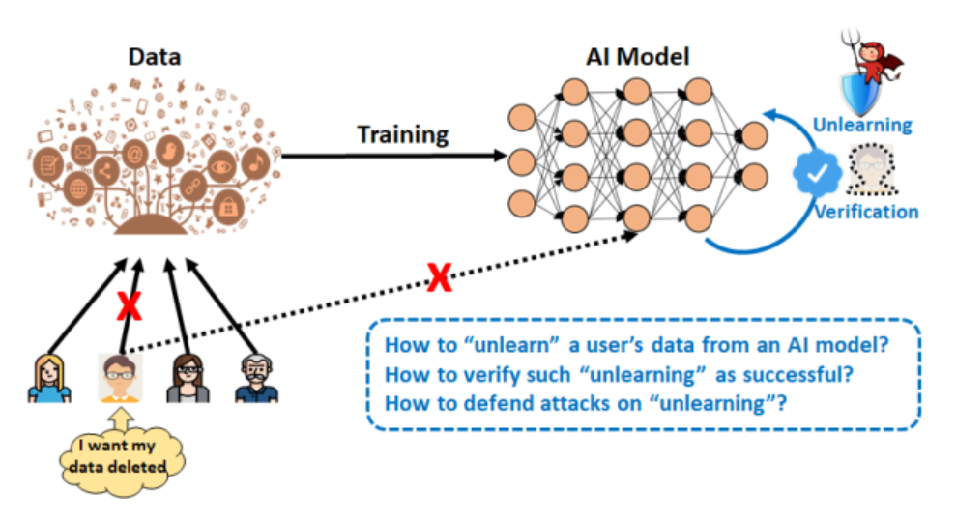
Introduction-III
Figure 1.2:Anatomy of unlearning.. (source: https://research.csiro.au/isp/research/privacy_mlai/privacy-and-machine-unlearning/
Machine Unlearning : Addressing the Challenge of Incorrectly Learned Information

Slide 7
Literature Review I
Author, Title, Journal | Dataset | Work-done | Findings
Cui et al. Improving Data Utility Through Game Theory in Personalized Differential Privacy Journal of Computer Science and Technology, 2019 | Google+ social network dataset (4,000 nodes, 56,352 edges) | Proposed a personalized differential privacy model based on social distance; modeled user-adversary interaction as a static Bayesian game; derived Bayesian Nash equilibrium using modified Q-learning | Personalized privacy improves data utility; game-theoretic modeling enables optimized trade-off between privacy and utility; fast convergence achieved via cardinality reduction
Machine Unlearning : Addressing the Challenge of Incorrectly Learned Information

Slide 8
Literature Review II
Author, Title, Journal | Dataset | Work-done | Findings
Liang et al. Investigating the Adoption of Hybrid Encrypted Cloud Data Deduplication With Game Theory IEEE TPDS, 2021 | Debian Popularity Contest dataset (434 data items, 309,052 holders) | Modeled stakeholder interactions (CSP, data owner, data holders) using a multi-stage Stackelberg game; proposed gradient-based algorithm to reach equilibrium | H-DEDU adoption depends on incentives and trust; deduplication is more accepted for popular data and trusted CSPs; game-theoretic modeling helps optimize pricing and participation strategies
Machine Unlearning : Addressing the Challenge of Incorrectly Learned Information

Slide 9
Literature Review III
Author, Title, Journal | Dataset | Work-done | Findings
Leonardos & Piliouras Exploration–Exploitation in Multi-Agent Learning: Catastrophe Theory Meets Game Theory Artificial Intelligence, 2022 | Synthetic simulations of multi-agent games | Developed Smooth Q-Learning (SQL) dynamics and linked them to Quantal Response Equilibria (QRE); used catastrophe theory to analyze bifurcations in learning dynamics | SQL converges to QRE with bounded regret; exploration can cause phase transitions with unpredictable outcomes; equilibrium selection is path-dependent and sensitive to exploration parameters
Machine Unlearning : Addressing the Challenge of Incorrectly Learned Information

Slide 10
Research Gaps
1. Lack of Strategic Modeling (Game Theory)
Trade-offs between unlearning accuracy and model utility.
Absence of strategic frameworks to model stakeholder interactions
2. Absence of Incentive Mechanisms
3. Unlearning in Multi-Agent and Federated Settings
4. Feature-Based and Partial Unlearning
5. Sequential and Dynamic Unlearning
6. Reinforcement ,Recommender Unlearning
7. Verification and Auditing Gaps
Machine Unlearning : Addressing the Challenge of Incorrectly Learned Information

Slide 11
Introduction-IV:
Bridging the Gap: Our Research Focus
Research Title: Game-Theory-Based Balance: Formalizing the Machine Unlearning Problem as a Game Between Model Provider and Data Provider
Key Points:
We model unlearning as a strategic interaction:
Model Provider: wants to retain utility and minimize cost.
Data Provider: wants their data forgotten with guarantees.
Game theory helps:
Formalize incentives and trade-offs.
Design equilibrium strategies for unlearning.
Analyze adversarial or cooperative behaviors.
Machine Unlearning : Addressing the Challenge of Incorrectly Learned Information

Slide 12
Objectives
UNGAME: A Game-Theoretic Architecture for Strategic Machine Unlearning Across Diverse Models (UNGAME : UNlearning Game-Theoretic Architecture for Model Equilibrium)
UNFEAT: Strategic Feature Unlearning with Equilibrium Verification and Auditing (UNFEAT : UNlearning Network for FEATure-based Analysis and Testing )
3. UNFED: Multi-Agent Game-Theoretic Modeling for Federated Machine Unlearning (UNFED: UNlearning in FEDerated systems )
Machine Unlearning : Addressing the Challenge of Incorrectly Learned Information

Slide 13
Research Gaps to Objectives Mapping
GAP-1
Lack of Strategic Modeling (Game Theory)
OBJECTIVE-1
UNGAME: A Game-Theoretic Architecture for Strategic Machine Unlearning Across Diverse Models
GAP-2
Absence of Incentive Mechanisms
OBJECTIVE-2
UNFEAT: Strategic Feature Unlearning with Equilibrium Verification and Auditing
GAP-3
Feature-Based and Partial Unlearning
OBJECTIVE-3
UNFED: Multi-Agent Game-Theoretic Modeling for Federated Machine Unlearning
GAP-4
Unlearning in Multi-Agent and Federated Settings
Machine Unlearning : Addressing the Challenge of Incorrectly Learned Information

Slide 14
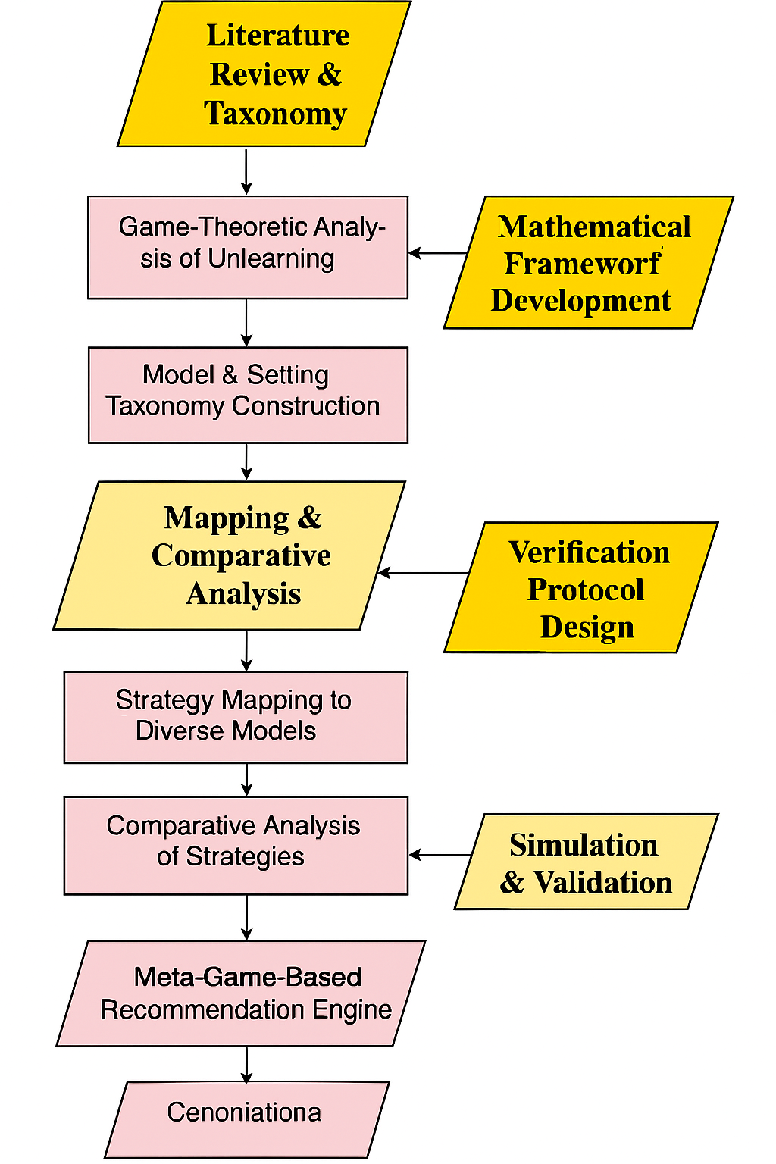
Objective 1: Methodology
Machine Unlearning : Addressing the Challenge of Incorrectly Learned Information

Slide 15
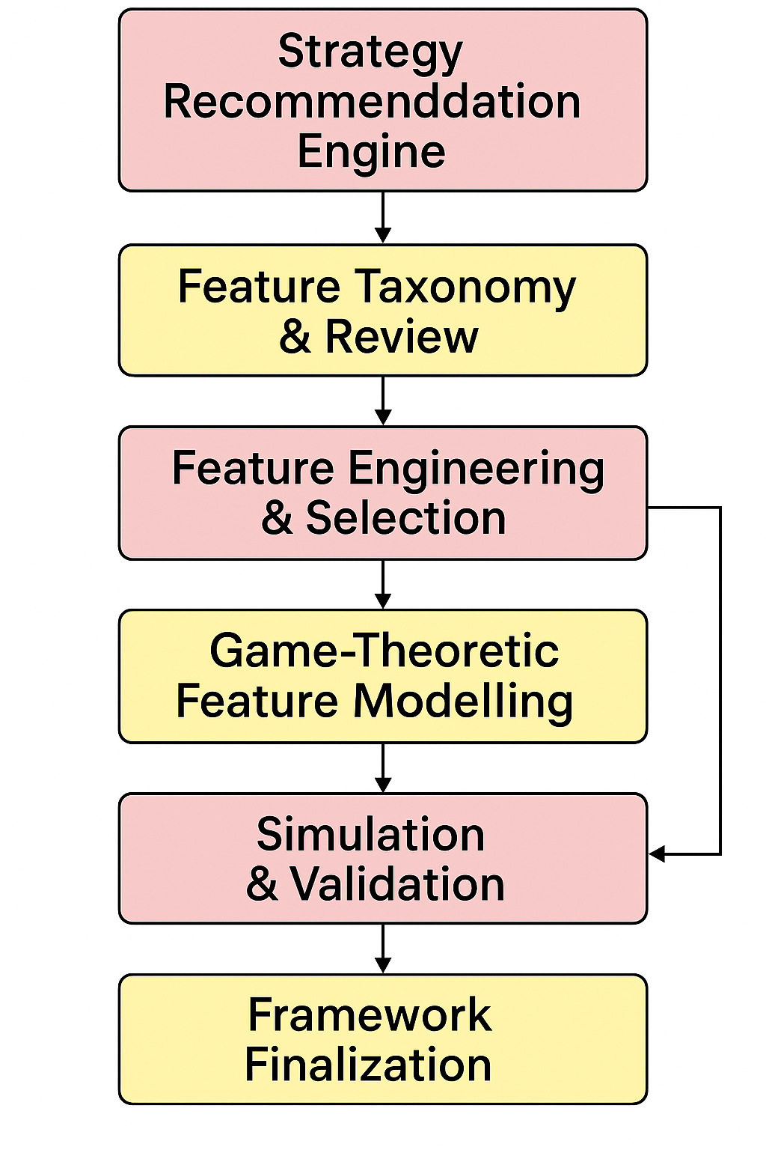
Objective 2: Methodology
Machine Unlearning : Addressing the Challenge of Incorrectly Learned Information

Slide 16
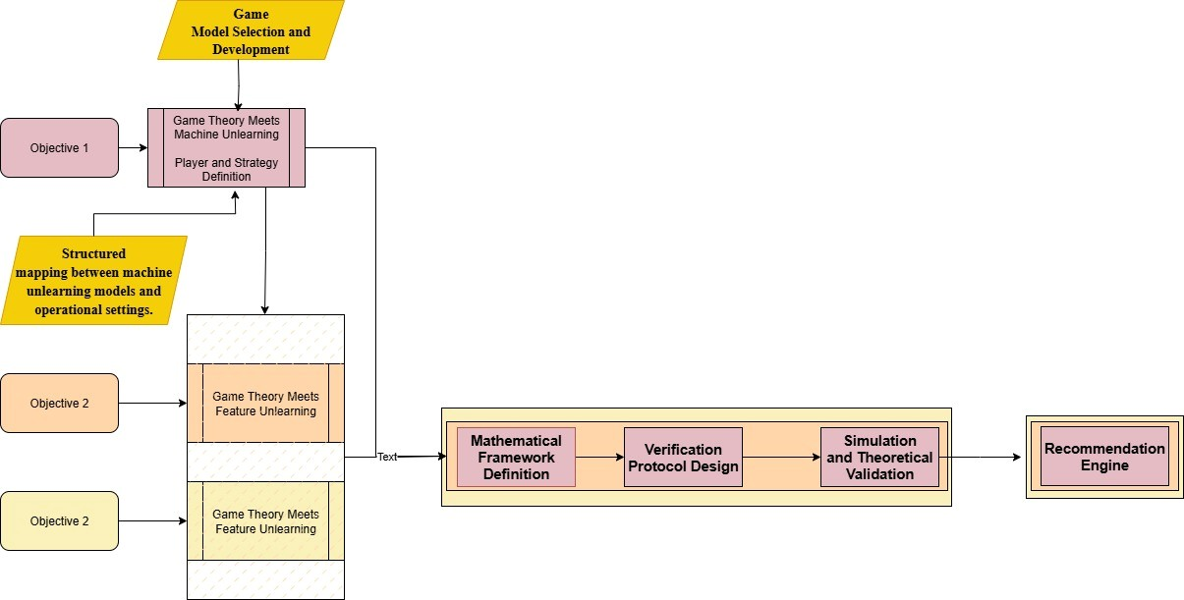
Methodology
Figure 5.1: Decision Support System for Liver Trauma Assessment workflow
Machine Unlearning : Addressing the Challenge of Incorrectly Learned Information

Slide 17
Course Work Details
S. No. | Title of Course Work | Credits | Status
1 | Advanced Research Methodology (ARM) | 4 | In-Progress
2 | Research and Publication Ethics (RPE) | 2 | Done
Machine Unlearning : Addressing the Challenge of Incorrectly Learned Information

Slide 18
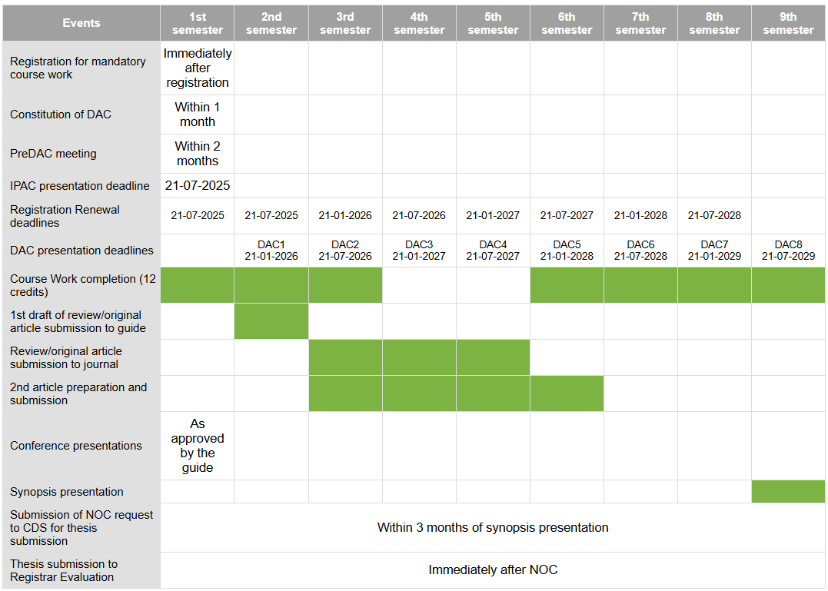
Time Plan
Machine Unlearning : Addressing the Challenge of Incorrectly Learned Information

Slide 19
References I
[1] Machine Unlearning: A Survey HENG XU, TIANQING ZHU, and LEFENG ZHANG, University of Technology Sydney, Australia WANLEI ZHOU, City University of Macau, China PHILIP S. YU, University of Illinois at Chicago, United States
[2] Machine Unlearning: A Comprehensive Survey WEIQI WANG, University of Technology Sydney, Australia ZHIYI TIAN, University of Technology Sydney, Australia CHENHAN ZHANG, University of Technology Sydney, Australia SHUI YU, University of Technology Sydney, Australia
[3] Stefanos Leonardos and Georgios Piliouras. 2022. Exploration-exploitation in multi-agent learning: Catastrophe theory meets game theory. Artif. Intell. 304 (2022), 103653. DOI:http://dx.doi.org/10.1016/j.artint.2021.103653
[4] Lei Cui, Youyang Qu, Mohammad Reza Nosouhi, Shui Yu, Jianwei Niu, and Gang Xie. 2019. Improving data utility through game theory in personalized differential privacy. J. Comput. Sci. Technol. 34, 2 (2019), 272–286. DOI:http: //dx.doi.org/10.1007/s11390-019-1910-3
[5] Xueqin Liang, Zheng Yan, Robert H. Deng, and Qinghua Zheng. 2021. Investigating the adoption of hybrid encrypted cloud data deduplication with game theory. IEEE Trans. Parallel Distrib. Syst. 32, 3 (2021), 587–600. DOI:http://dx.doi. org/10.1109/TPDS.2020.3028685
[6] Jiahui Geng, Qing Li, Herbert Woisetschlaeger, Zongxiong Chen, Fengyu Cai, Yuxia Wang, Preslav Nakov, Hans-Arno Jacobsen, Fakhri Karray A Comprehensive Survey of Machine Unlearning Techniques for Large Language Models DOI: https://doi.org/10.48550/arXiv.2503.01854
[7] Exploring Federated Unlearning: Review, Comparison, and Insights Yang Zhao, Member, IEEE, Jiaxi Yang, Student Member, IEEE, Yiling Tao, Student Member, IEEE, Lixu Wang, Student Member, IEEE, Xiaoxiao Li, Member, IEEE, Dusit Niyato, Fellow, IEEE, and H. Vincent Poor, Life Fellow, IEEE
[8] Chuan Guo, Tom Goldstein, Awni Y. Hannun, and Laurens van der Maaten. 2020. Certified data removal from machine learning models. In 37th International Conference on Machine Learning (Proceedings of Machine Learning Research, Vol. 119). PMLR, 3832–3842. Retrieved from http://proceedings.mlr.press/v119/guo20c.html.
Machine Unlearning : Addressing the Challenge of Incorrectly Learned Information

Slide 20
References II
[9] Reinforcement Unlearning Dayong Ye∗ , Tianqing Zhu† , Congcong Zhu† , Derui Wang‡ , Kun Gao∗ , Zewei Shi‡ , Sheng Shen, Wanlei Zhou† , and Minhui Xue‡ ∗University of Technology Sydney, †City University of Macau, ‡CSIRO’s Data61, Torrens University Australia, https://arxiv.org/pdf/2312.15910
[10] Xiaofeng Ding, Hongbiao Fang, Zhilin Zhang, Kim-Kwang Raymond Choo, and Hai Jin. 2022. Privacy-preserving feature extraction via adversarial training. IEEE Trans. Knowl. Data Eng. 34, 4 (2022), 1967–1979. DOI:http://dx.doi. org/10.1109/TKDE.2020.2997604
[11] Bo Zhang, Hancheng Ye, Gang Yu, Bin Wang, Yike Wu, Jiayuan Fan, and Tao Chen. 2022. Sample-centric feature generation for semi-supervised few-shot learning. IEEE Trans. Image Process. 31 (2022), 2309–2320. DOI:http://dx. doi.org/10.1109/TIP.2022.3154938
[12] Jiajing Zhu, Yongguo Liu, Chuanbiao Wen, and Xindong Wu. 2022. DGDFS: Dependence Guided Discriminative Feature Selection for predicting adverse drug-drug interaction. IEEE Trans. Knowl. Data Eng. 34, 1 (2022), 271–285. DOI:http://dx.doi.org/10.1109/TKDE.2020.2978055
[13] [Wu et al., 2023] Xinwei Wu, Junzhuo Li, Minghui Xu, Weilong Dong, Shuangzhi Wu, Chao Bian, and Deyi Xiong. DEPN: Detecting and editing privacy neurons in pretrained language models. In Houda Bouamor, Juan Pino, and Kalika Bali, editors, Proceedings of the 2023 Conference on Empirical Methods in Natural Language Processing, pages 2875–2886, Singapore, December 2023. Association for Computational Linguistics.
[14] [Jia et al., 2024] Jinghan Jia, Jiancheng Liu, Yihua Zhang, Parikshit Ram, Nathalie Baracaldo, and Sijia Liu. WAGLE: Strategic weight attribution for effective and modular unlearning in large language models. In The Thirty-eighth Annual Conf
[15] A Survey on Recommendation Unlearning: Fundamentals, Taxonomy, Evaluation, and Open Questions Yuyuan Li, Xiaohua Feng, Chaochao Chen*, Senior Member, IEEE, and Qiang Yang, Fellow, IEEE

Slide 21
Thank You
Machine Unlearning : Addressing the Challenge of Incorrectly Learned Information

